Slide 1


Slide 2
Poultry and Other Protein Market Trends in the United States and Latin America
Mark Jordan
Executive Director
LEAP Market Analytics
mark.jordan@leapmarkets.com

Slide 3
Before We Begin…
Clarifying use of the term “broiler” versus “chicken.”
As defined by the United States Department of Agriculture (USDA), a broiler is a chicken younger than 10 weeks old of either sex that has tender meat, smooth-textured skin, and flexible breastbone cartilage.
A broiler, then, is just a young chicken (pollo joven).
Most of the charts you’ll see are generated automatically from my database and include the “broiler” designation.
But I’ll do my best to use “chicken” when speaking.

Slide 4
Introductory Market Highlights
U.S.-Iran conflict continues to destabilize fuel, fertilizer, and feed input markets, with multiplier effects beyond those spaces.
Weaker dollar (USD) opens doors for U.S. exporters while creating opportunities for importers.
Severe drought across most of the Southern/Central Plains and Southeastern U.S. introduces early-season yield concerns.
Upside price risks greater for corn than soybean meal.
U.S. chicken companies in “mediocre” financial shape.

Slide 5
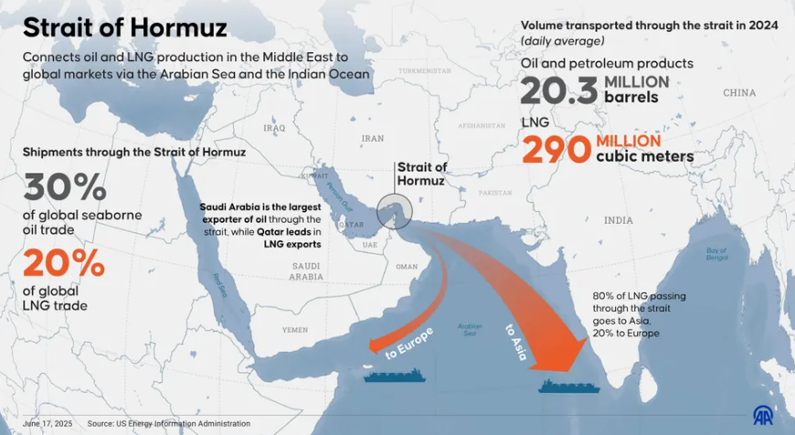
Disruption Risks Grow for Fuel and Fertilizer as Battle Over Strait of Hormuz Continues

Slide 6
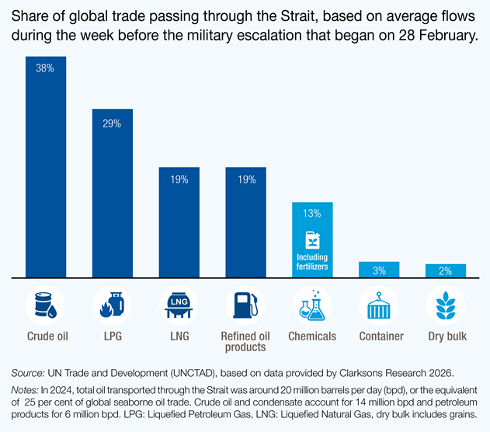
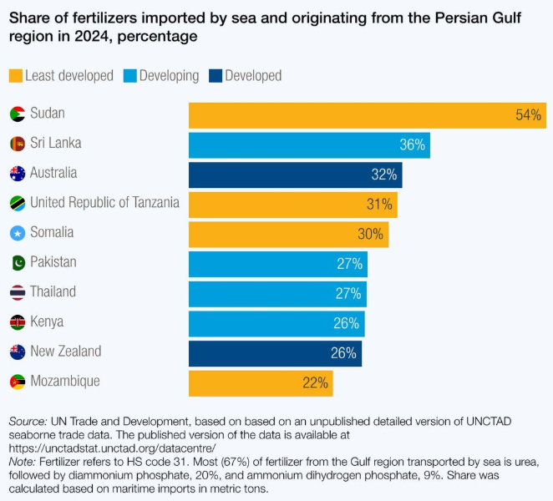
About One-Third of Global Seaborne Fertilizer Passes Through the Strait of Hormuz

Slide 7
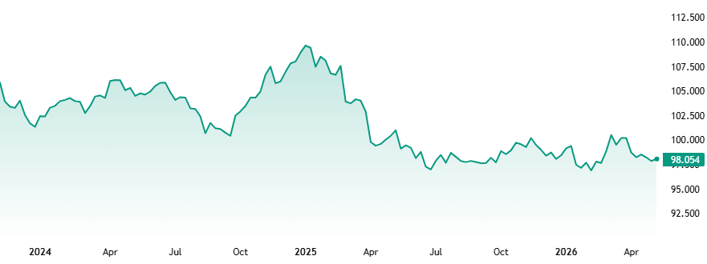
U.S. Dollar Index Trends Mostly Sideways Over the Past Year
U.S. Dollar Index (DXY)
as of May 8th
Source: TradingView

Slide 8
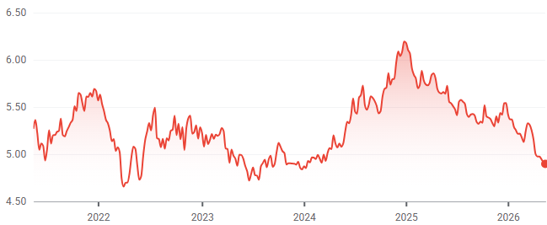
United States Dollar Versus Brazilian Real
from more than 6:1 to less than 5:1 (as of May 8th) since early 2025
USD to BRL
Source: Google Finance

Slide 9
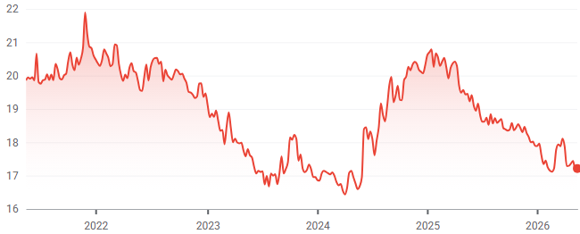
United States Dollar Versus Mexican Peso
from nearly 21:1 to just over 17:1 (as of May 8th) since early 2025
USD to MXN
Source: Google Finance

Slide 10
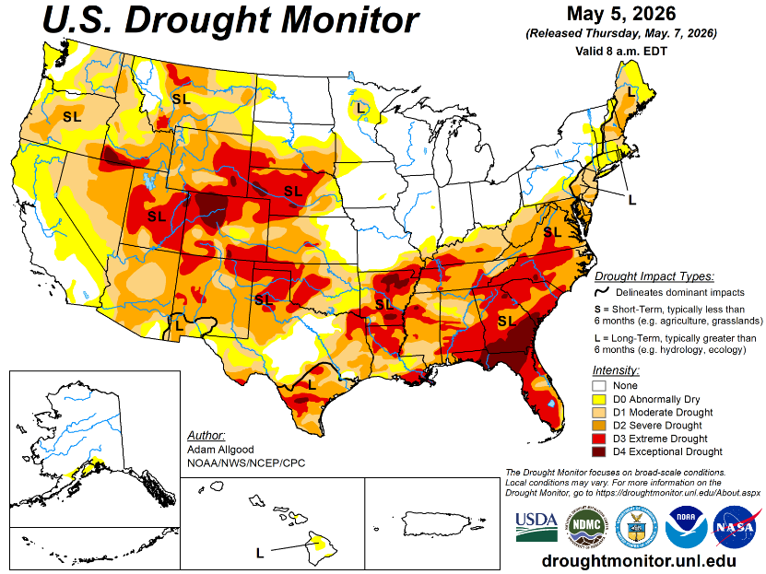
Severe Drought Blankets Much of the U.S. Outside of the Crucial Midwest Region
Current U.S. weather patterns contain “echoes from 2012.”
Globally, a transition from a La Nina weather pattern to El Nino is expected by later this year, with some forecasters suggesting there is a 1-in-4 chance of a “Super El Nino” on the horizon.

Slide 11
Corn Yield Prospects Dampened by Drought Concerns and Diminished Fertilizer Access
A shortfall comparable to 2012 (in percentage terms, versus trend) would result in an average U.S. corn yield this year of around 140-145 bushels per acre.
Sources: USDA, LEAP Market Analytics

Slide 12
Soybean Acreage Likely to Increase This Year, Limiting Upside Price Pressures in This Space
Soybeans represent one of the very few options among major row crops for U.S. farmers to be profitable this year.
Sources: USDA, LEAP Market Analytics

Slide 13
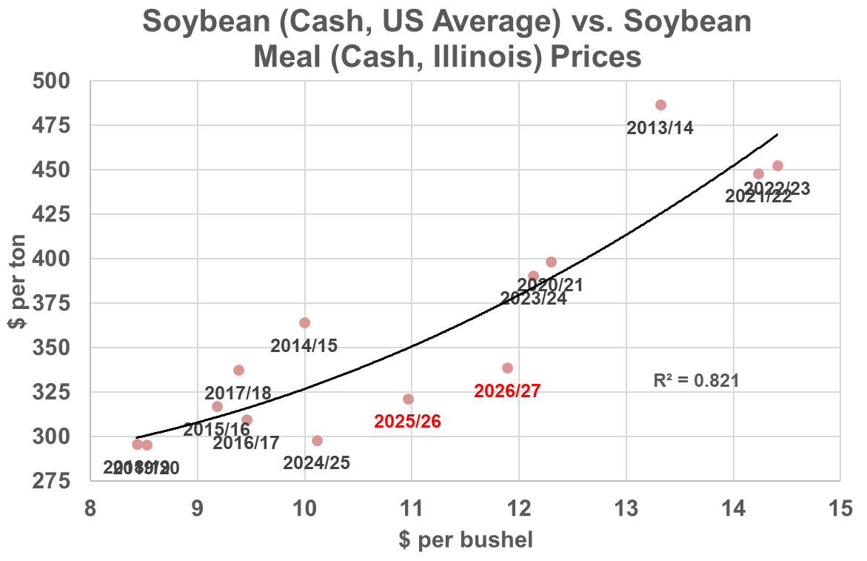
Added Crushing Capacity in the U.S. Limits Upside Price Pressures for Soybean Meal
Driven by growing domestic demand for renewable diesel, total U.S. soybean crushing capacity increased roughly 14% between early 2023 and early 2025.
This added capacity and relative strength in soybean oil demand and pricing has kept meal prices discounted on a relative basis.
Sources: USDA, LEAP Market Analytics

Slide 14
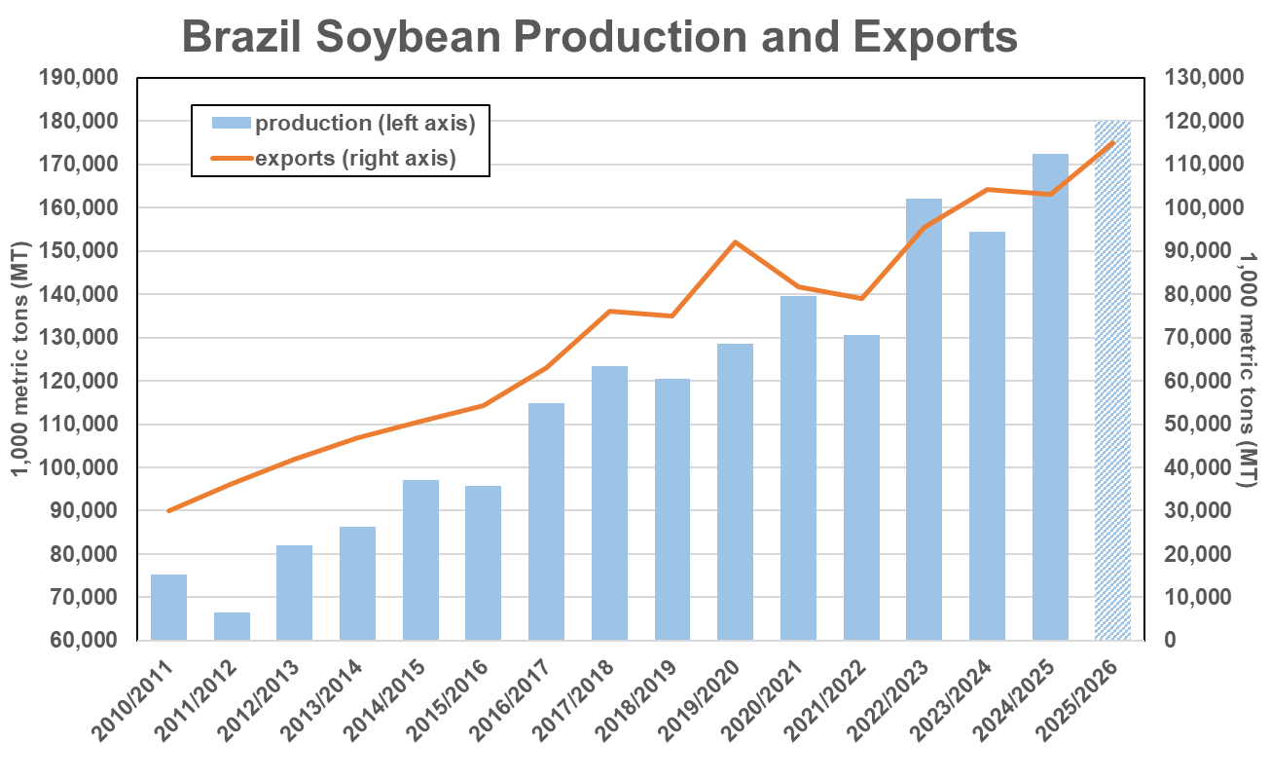
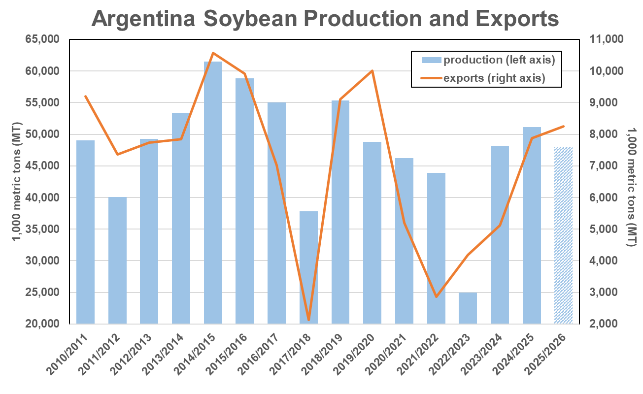
Brazil Is Expected to Export a Record 115 Million Metric Tons of Soybeans This Year
Total soybean production in Brazil and Argentina combined this year is expected to increase only 2% from last year’s harvest.
Source: USDA-FAS
Source: USDA-FAS

Slide 15
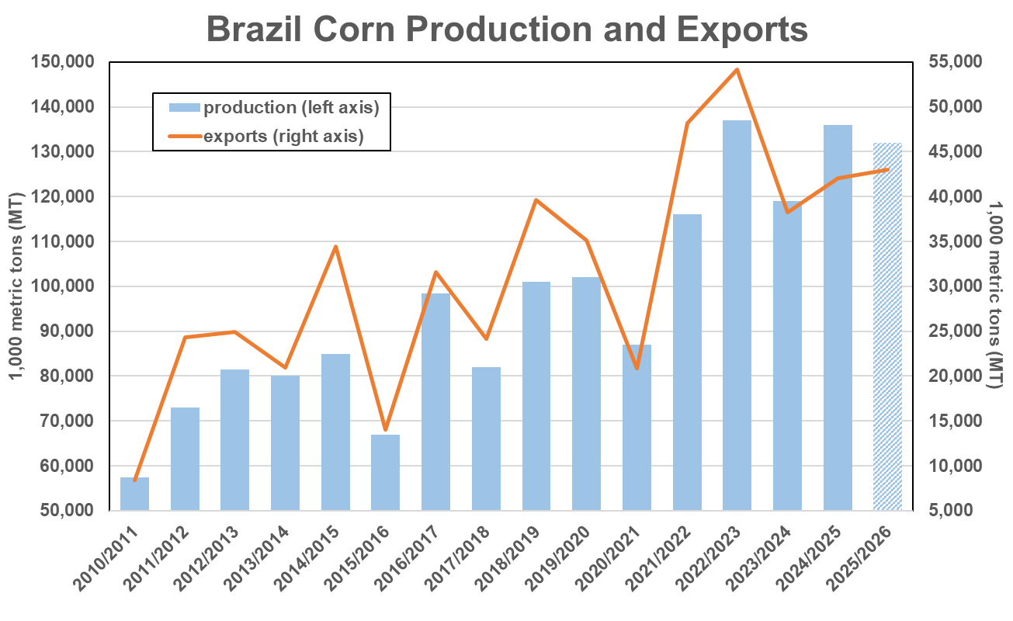
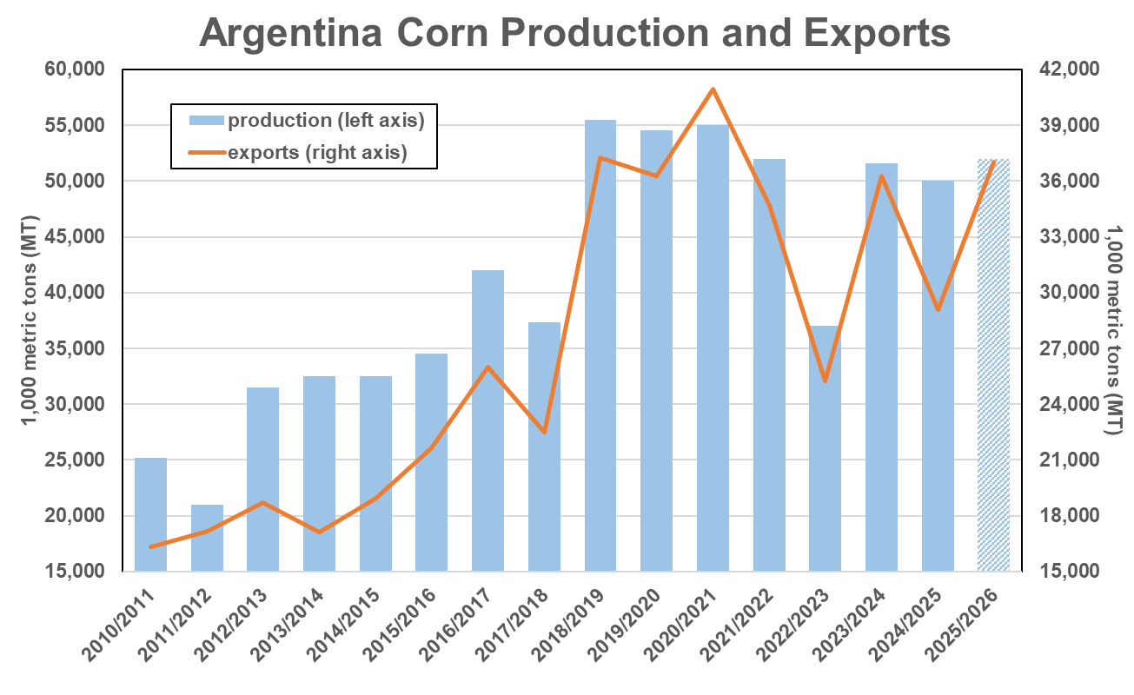
Corn Production Has Stalled in Both Brazil and Argentina
Total corn production in Brazil and Argentina combined this year is expected to decline 1% from last year’s harvest.
Source: USDA-FAS
Source: USDA-FAS

Slide 16
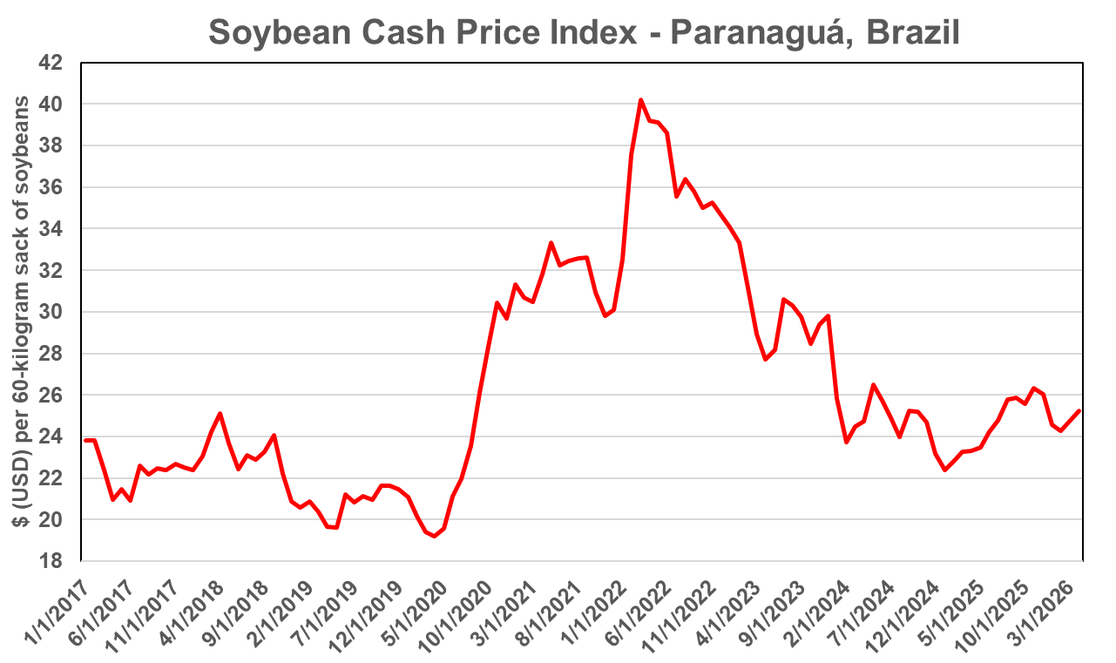
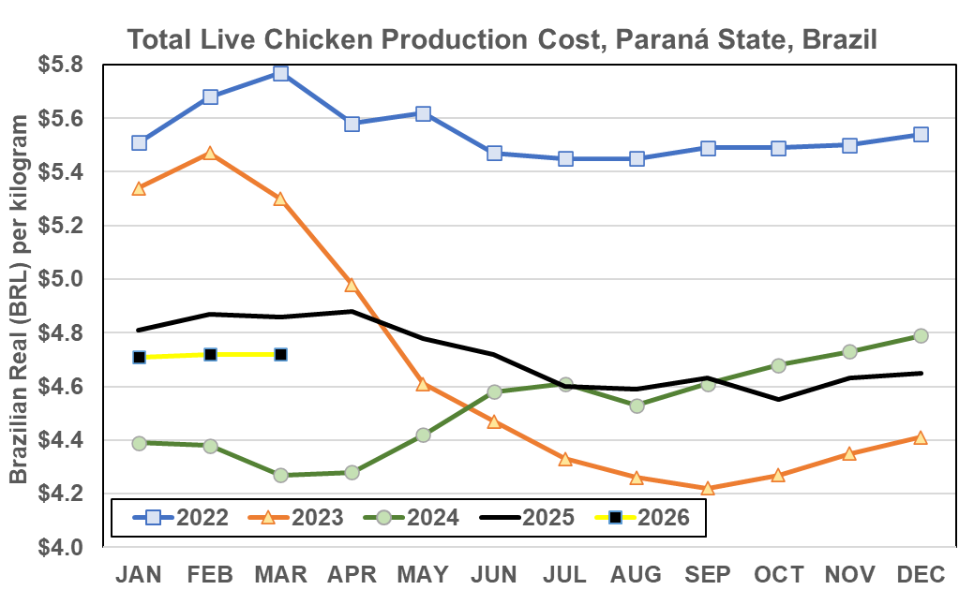
Live Chicken Production Costs in the U.S. Now Roughly on Par with Brazil
Brazil’s Q1 average equivalent to roughly $0.43 per pound (USD) where $1 USD = $5 BRL.
Estimated U.S. average during the same period was $0.42 per pound.
Source: OAA Brasilia-CEPEA
Source: Embrapa (ICPFrango)

Slide 17
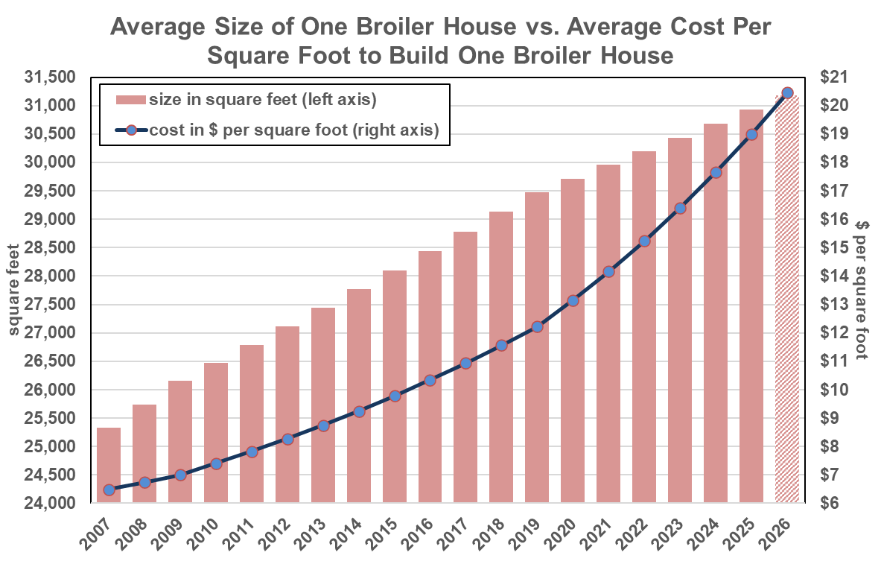
Cost of Constructing a New Chicken House in the U.S. Surpasses $20 Per Square Foot
New building and construction costs have increased at an accelerating pace since 2020.
This is the primary area where the U.S. is least competitive with Brazil and most other exporters.
One new chicken house now costs more than $600,000, on average.
Source: LEAP Market Analytics

Slide 18
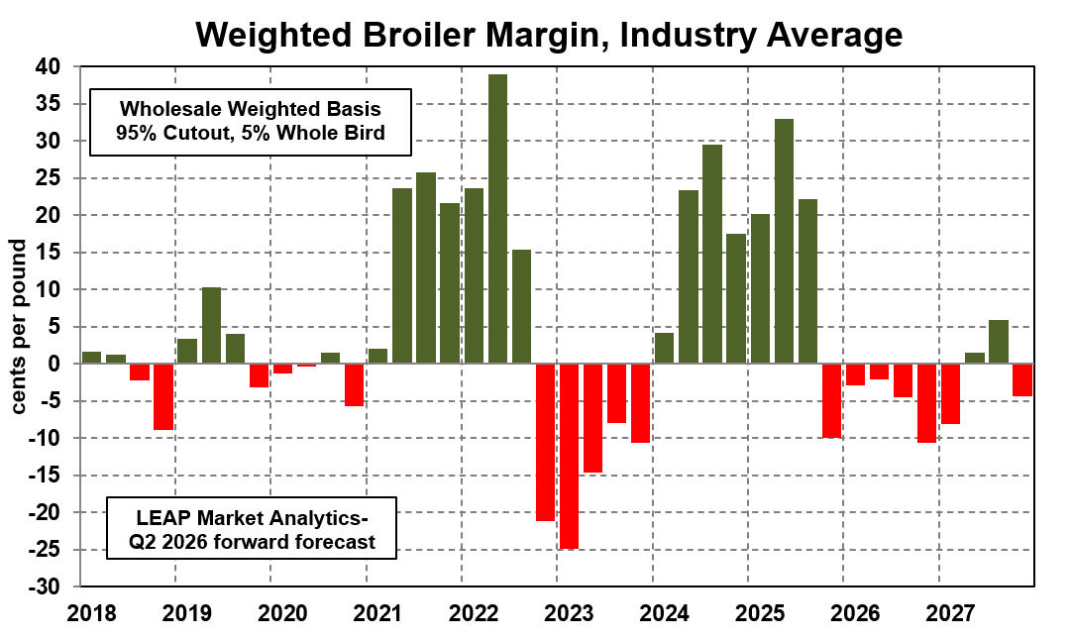
Spot Profit Margins for U.S. Chicken Companies Have Been Mediocre Recently
Going back to 2021, there have been wild swings in profitability (based on spot market conditions) for chicken integrators in the U.S.
These past few months represent one of the rare periods where conditions are neither particularly good nor bad.
Source: LEAP Market Analytics

Slide 19
Supply and Demand Situation for Chicken in the United States
Driven by efficiency gains, the U.S. chicken industry is expanding at one of the fastest rates in recent memory.
Ready-to-cook (RTC) production is on track to increase more than 3.0% this year, which would mark only the fourth year of the past two decades with growth above that threshold.
Lackluster exports further bolster domestic availability of chicken, which could be nearing a point of “market saturation.”
Wings may be an opportunity for importers again.
Dark meat demand in the U.S. is strong.

Slide 20
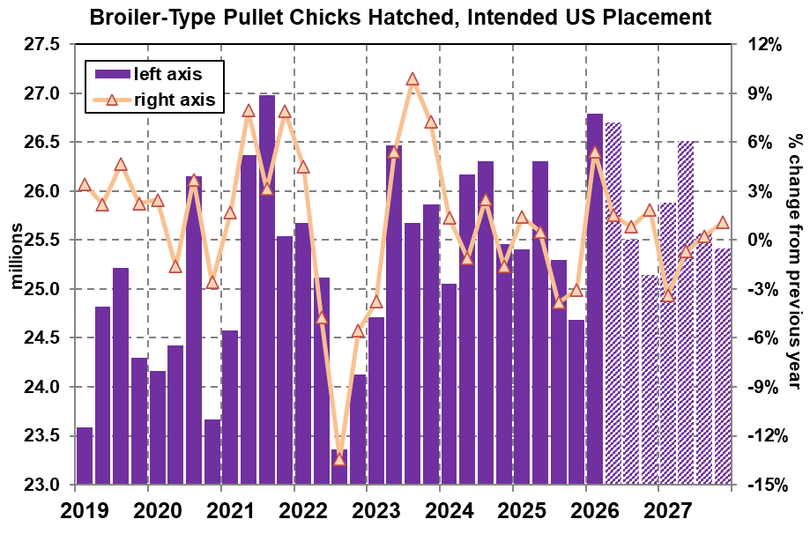
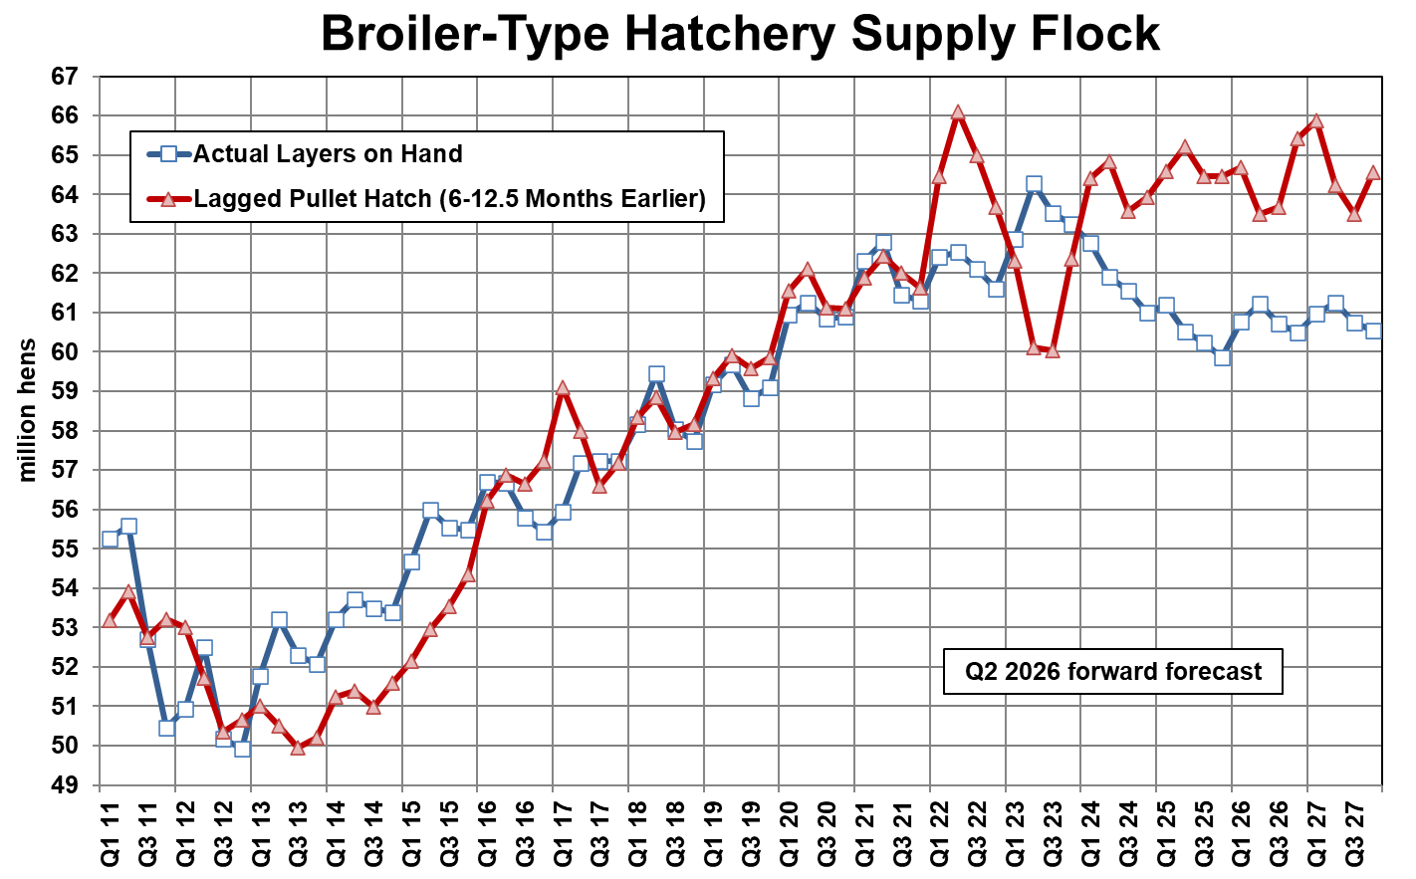
Large Gap Between Actual and Pullet-Implied Breeding Hen Inventories
Actual layer inventories are down at least 2-3 million from the number that should be on hand.
Sources: USDA, LEAP Market Analytics
Sources: LEAP Market Analytics

Slide 21
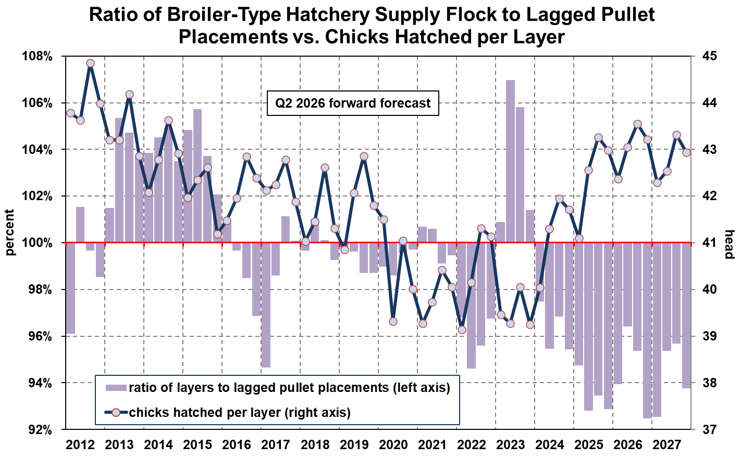
This Suggests Breeder Flocks Are “Current” – and Productive, by Extension
The average number of chicks hatched per layer increased an impressive 4.4% overall in 2024, increased another 3.0% overall last year, and posted yet another 3.1% increase from prior-year levels during the first quarter (Jan-Mar) of 2026.
Sources: USDA, LEAP Market Analytics

Slide 22
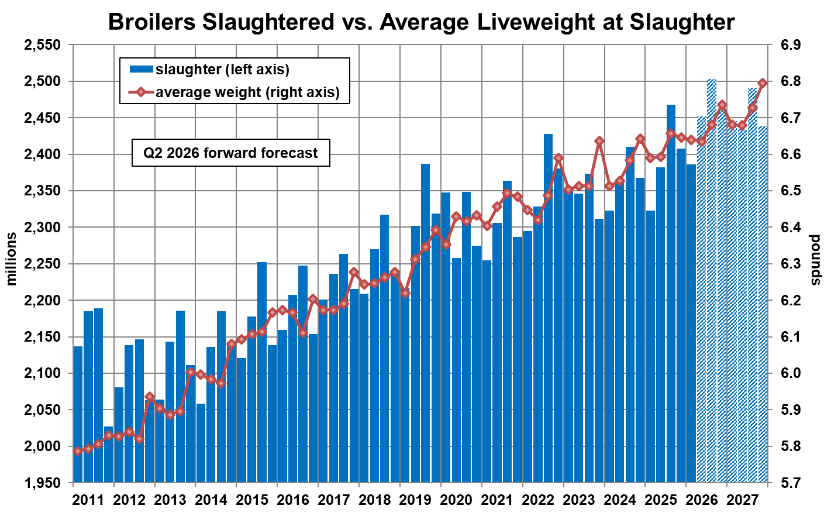
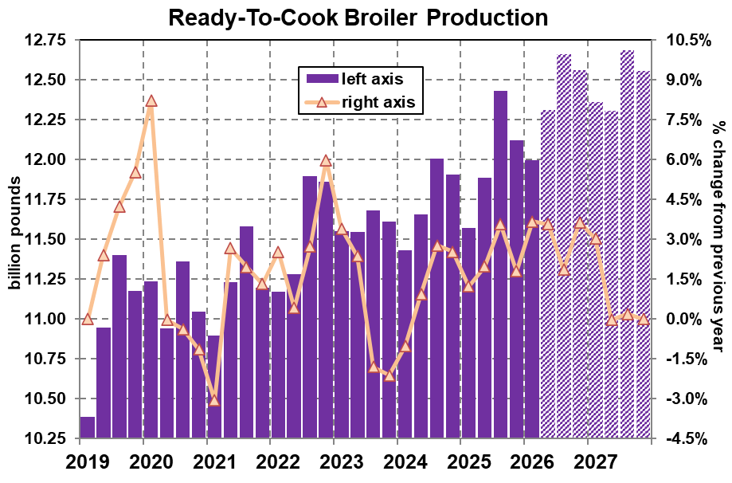
U.S. Chicken Production Expanding Rapidly at Present; Slower Growth Expected in 2027
Ready-to-cook (RTC) production volume increased 3.7% from a year earlier during the first quarter (Jan-Mar) of 2026.
Sources: USDA, LEAP Market Analytics
Sources: LEAP Market Analytics

Slide 23
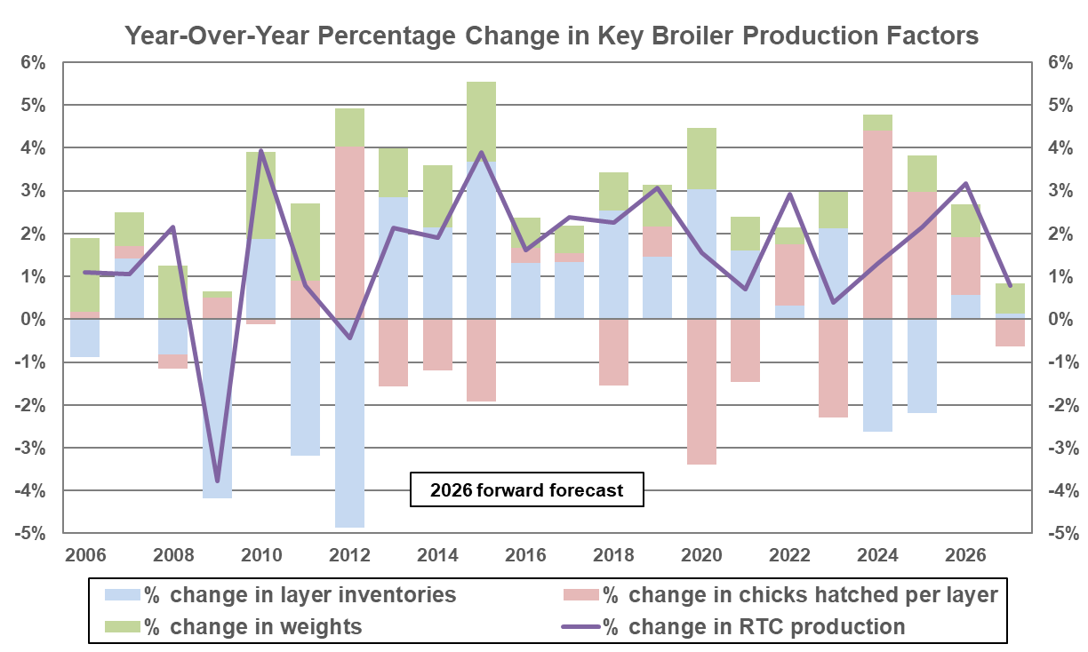
U.S. Chicken Production Has Increased by an Average of 2.0% Per Year Since 2012
All underlying production factors – including the size of the overall breeder flock, breeder productivity, livability, and finishing weights – are making positive contributions to industry growth right now.
Growth in RTC production should exceed 3.0% overall this year, which would mark only the 4th time that’s happened over the past two decades.
Sources: USDA, LEAP Market Analytics

Slide 24
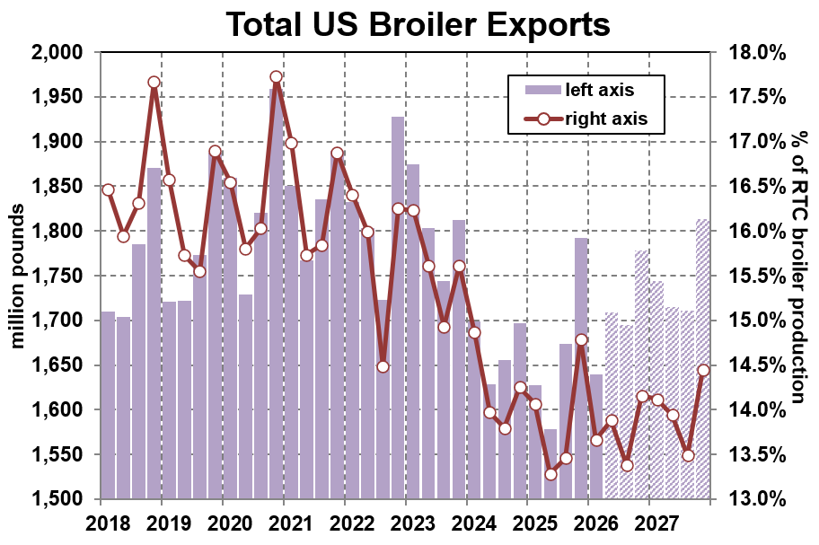
Total U.S. Chicken Exports Have Declined in Each of the Past Five Years
Following a 5.6% increase during the fourth quarter (Oct-Dec) of 2025, total US chicken exports posted a much more modest 0.7% increase from last year during the first quarter (Jan-Mar) of 2026.
Exports accounted for just 13.9% of domestic RTC production last year, representing the lowest share of production going into the export market since 1994.
Sources: USDA-ERS, LEAP Market Analytics

Slide 25
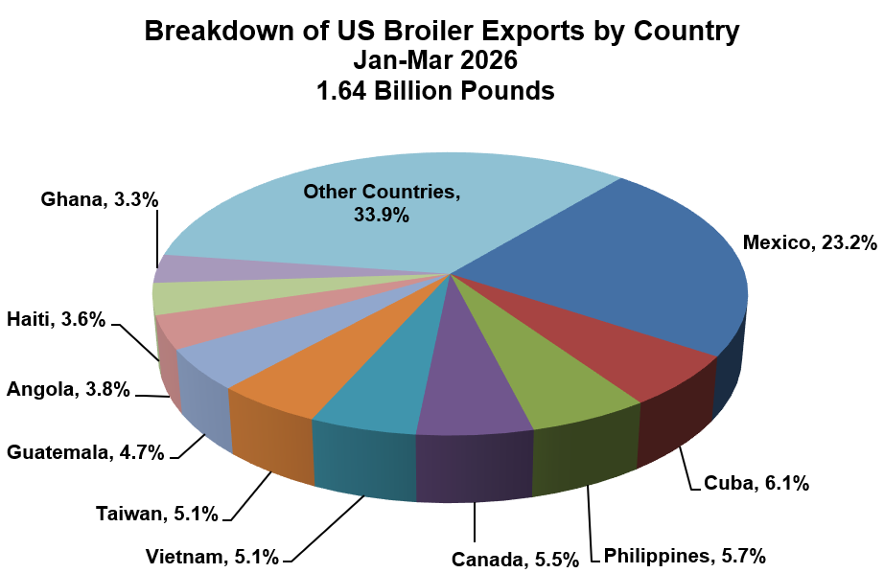
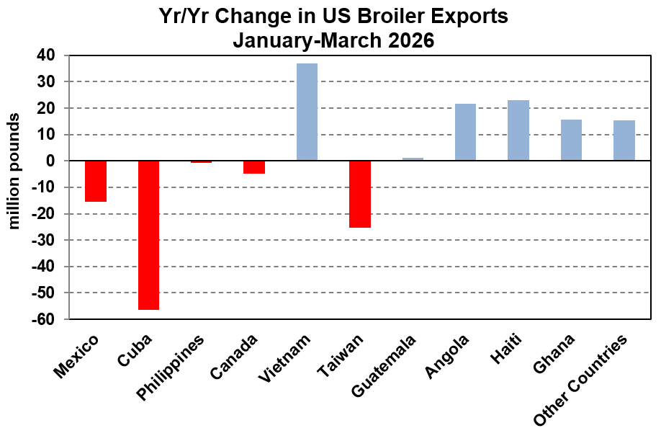
Exports to Top Destinations Have Languished so far in 2026; Increases Observed Elsewhere
U.S. chicken exports to Cuba plunged 36% from last year during the first quarter (Jan-Mar) of 2026.
Source: USDA-ERS
Source: USDA-ERS

Slide 26
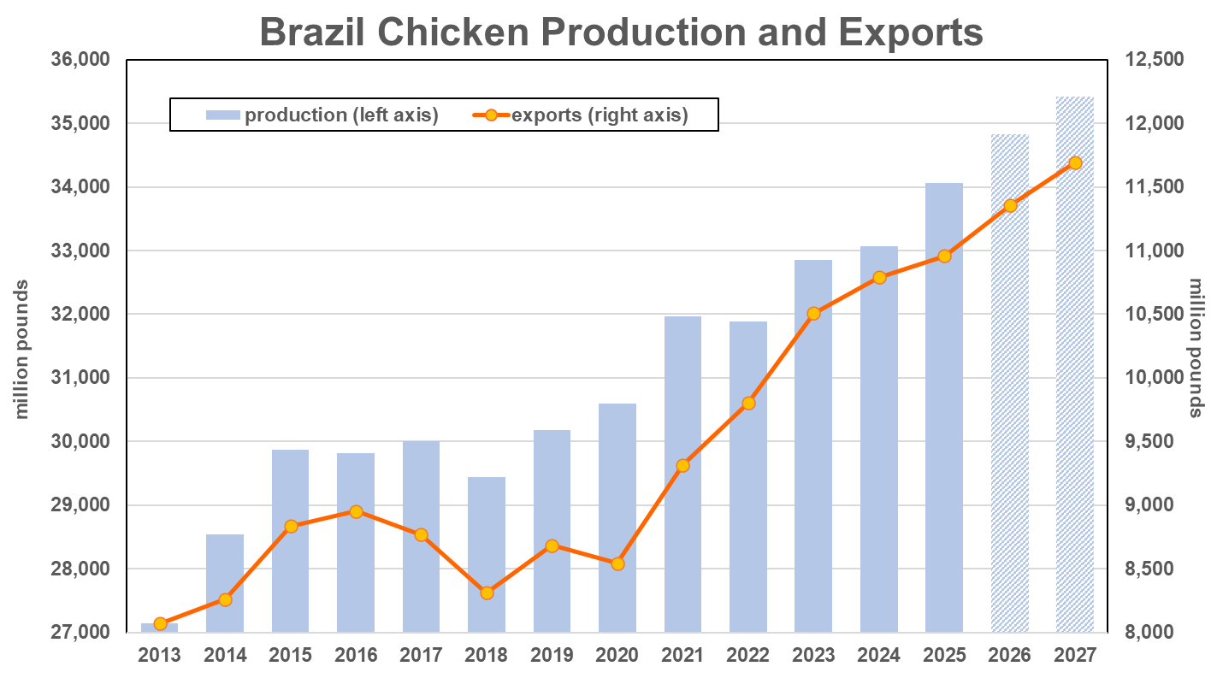
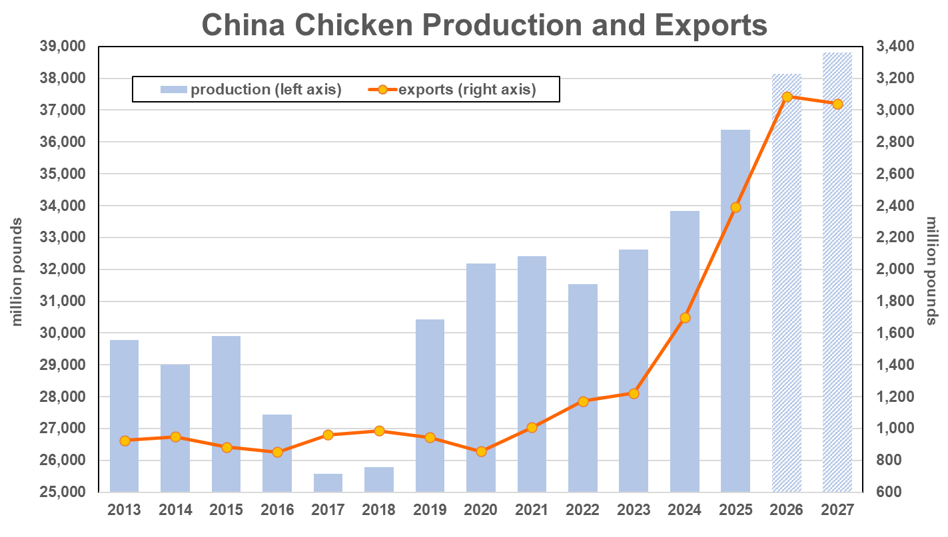
Export Share of Brazilian Chicken Production Has Stabilized at around 33%
China exported 6.6% of its chicken production in 2025, a modern record.
Led by Poland, the European Union (EU) is becoming more prominent in global chicken trade.
Source: USDA-FAS
Source: USDA-FAS

Slide 27
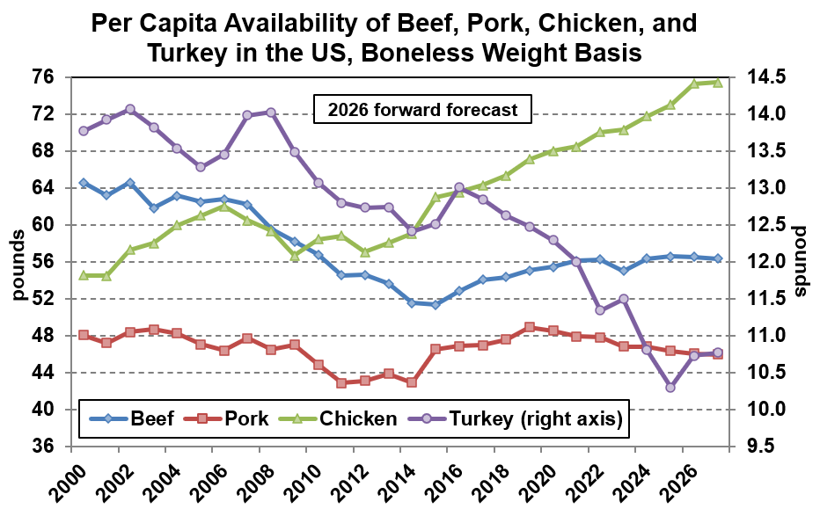
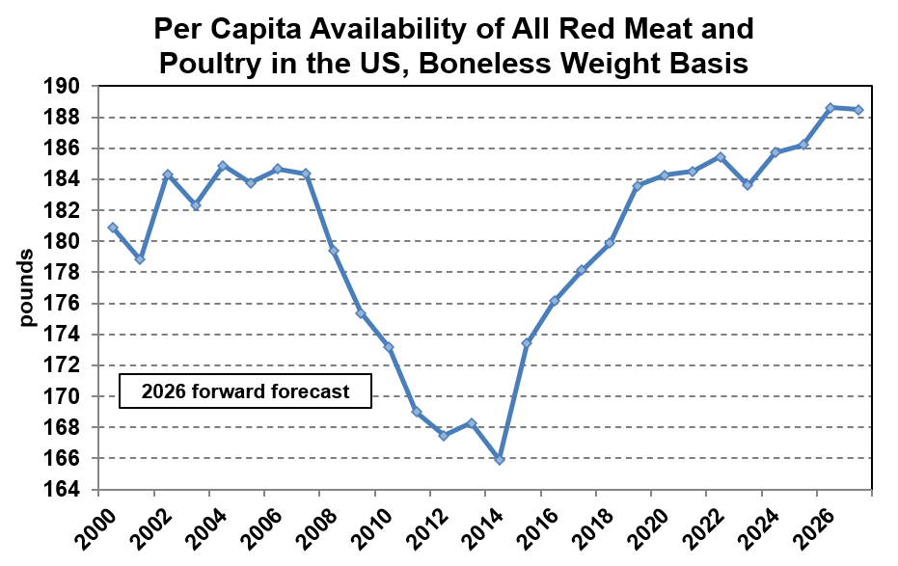
Per Capita Availability of Red Meat and Poultry in the U.S. Is Record Large and Climbing
Chicken’s share of the overall total was 36.0% a decade ago (in 2016), a record 39.2% last year, and is expected to clear 40.0% this year.
Sources: USDA, LEAP Market Analytics
Sources: USDA, LEAP Market Analytics

Slide 28
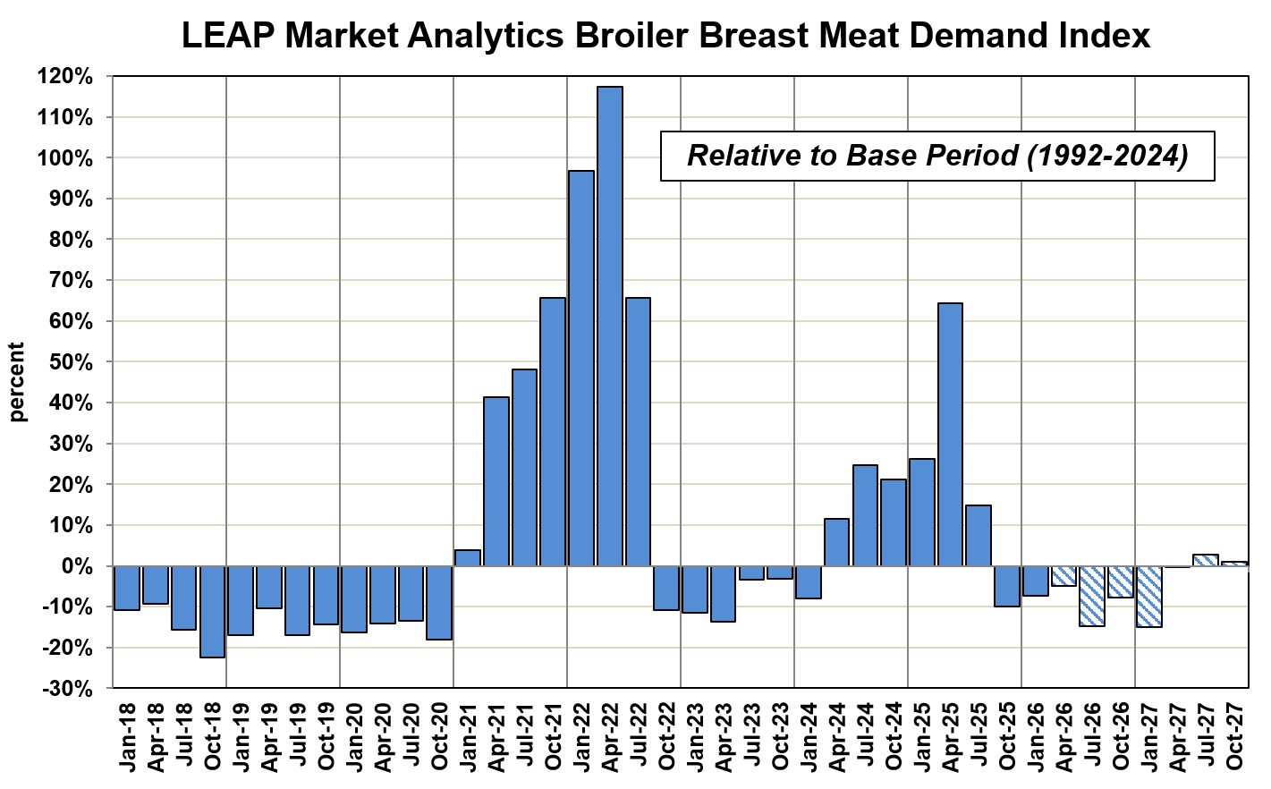
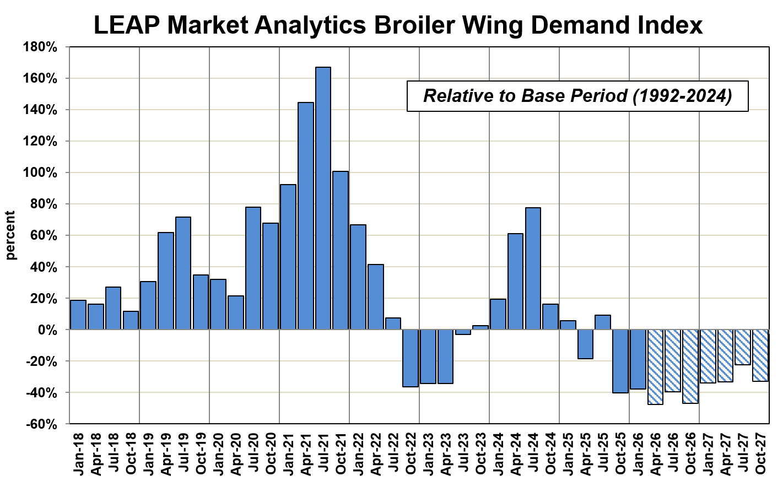
Soft Demand for White Meat Cuts in the U.S. Opens Opportunities for Importers
Wings represent an opportunity for importers again with sagging demand in the U.S. pushing spot wholesale prices deep into sub-$1 territory, even below $0.75 per pound.
Source: LEAP Market Analytics
Source: LEAP Market Analytics

Slide 29
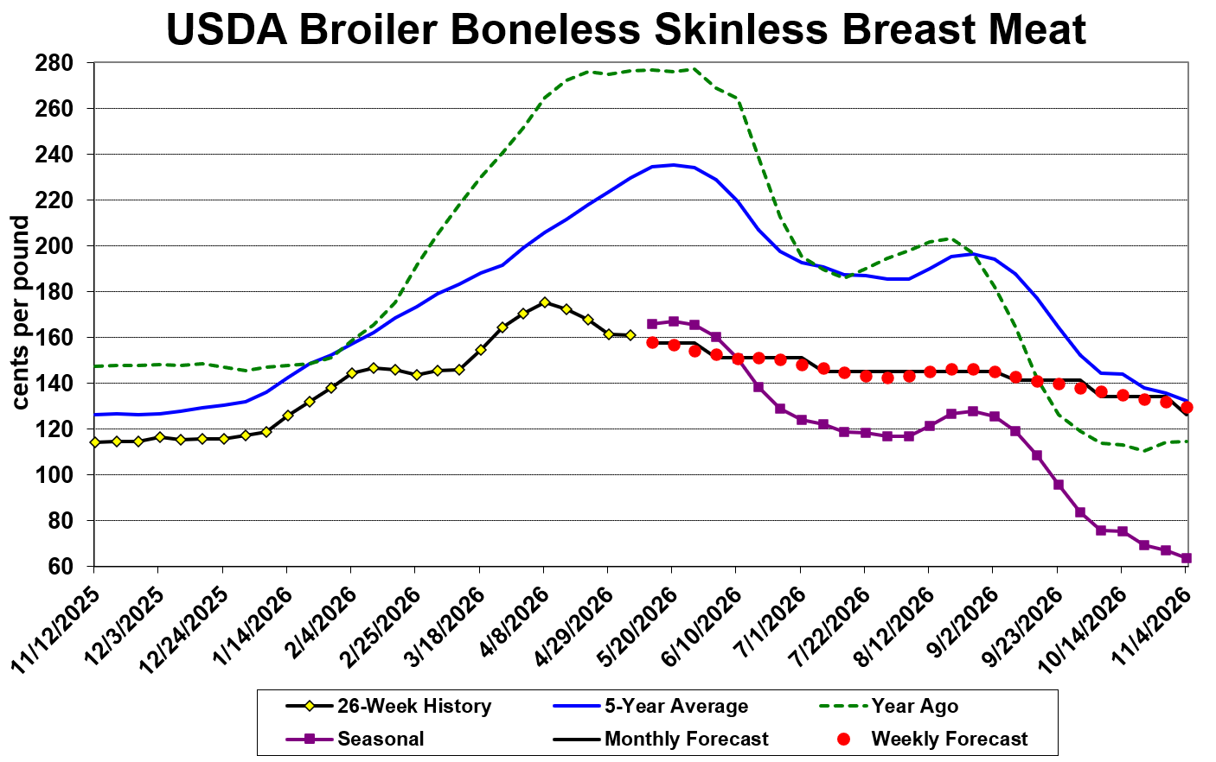
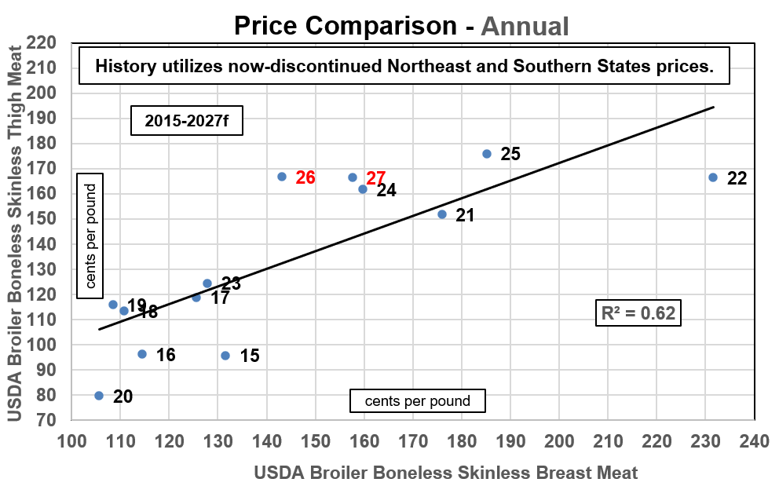
Demand Shifts Favor Dark Meat, Boneless Thigh Meat in Particular
Boneless skinless (b/s) thigh meat has consistently outperformed the b/s breast meat market recently, with 2026 shaping up to be a historic year for b/s thigh meat.
Sources: USDA-AMS, LEAP Market Analytics
Sources: USDA-AMS, LEAP Market Analytics

Slide 30
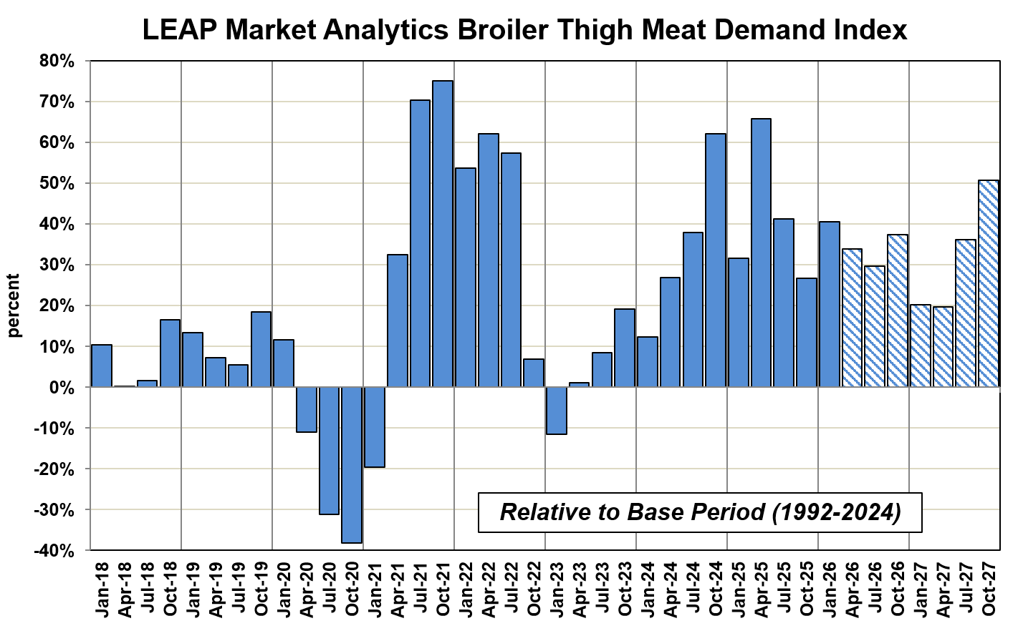
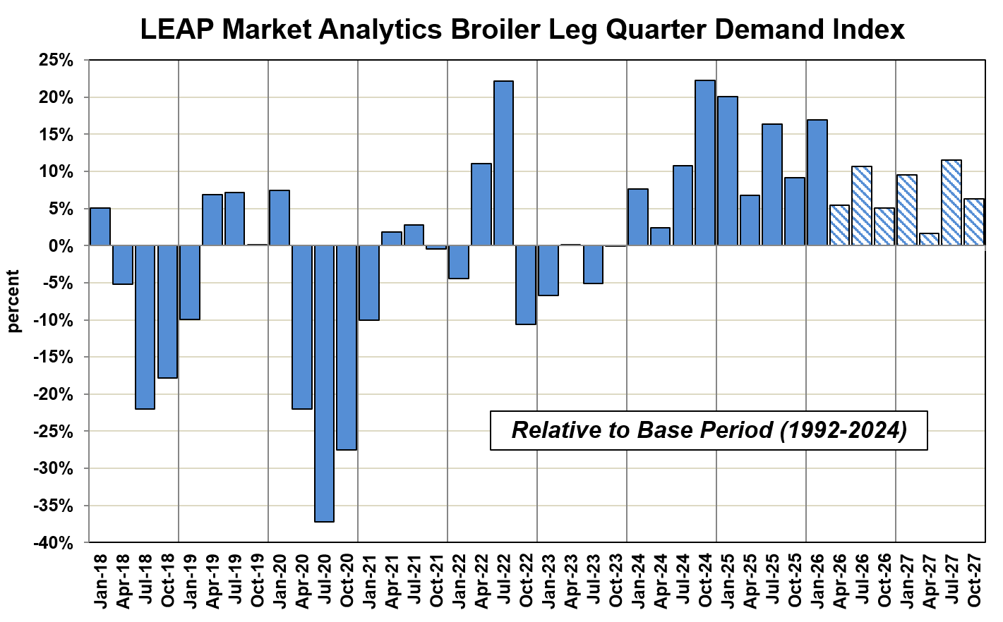
Even Bone-In Dark Meat Cuts Enjoying an Extended Run of Strong Domestic Demand
Wholesale and seasonally-adjusted leg quarter demand has remained above the baseline average since late 2023.
Source: LEAP Market Analytics
Source: LEAP Market Analytics

Slide 31
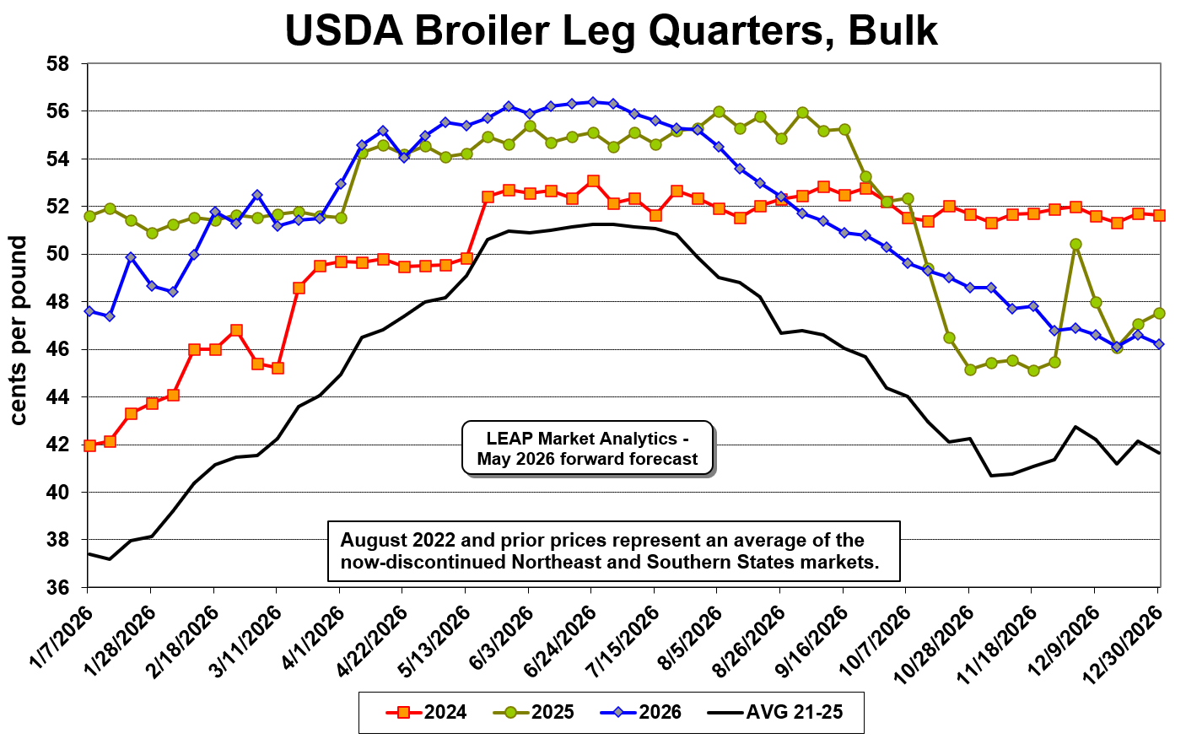
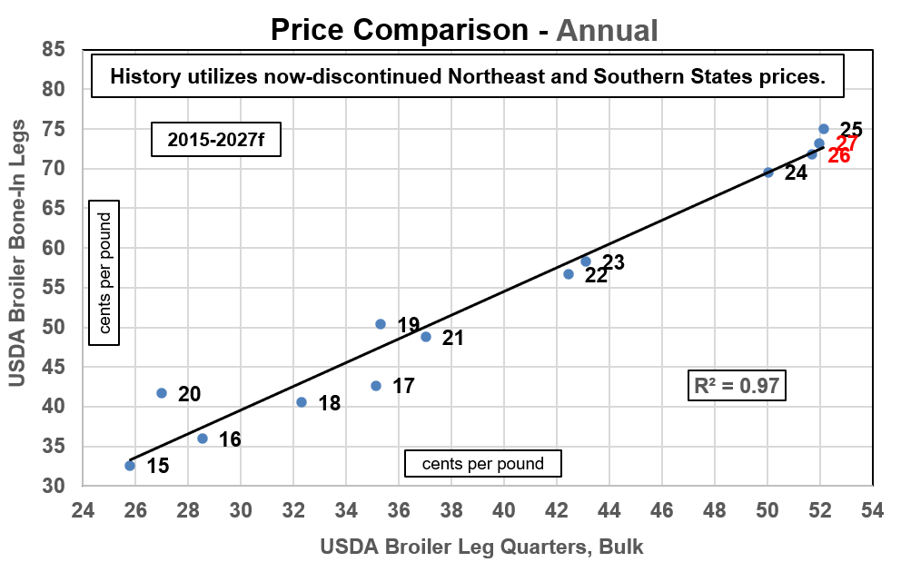
Bulk Fresh Leg Quarters Find Consistent Support Above $0.50 Per Pound
Leg quarter and whole leg markets constrained by supply growth and sluggish export demand but well supported from strong domestic demand.
Sources: USDA-AMS, LEAP Market Analytics
Sources: USDA-AMS, LEAP Market Analytics

Slide 32
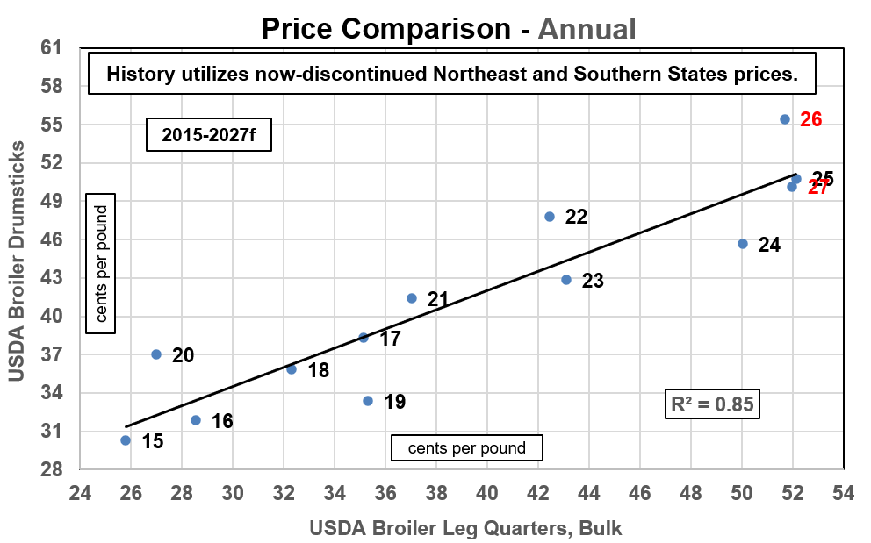
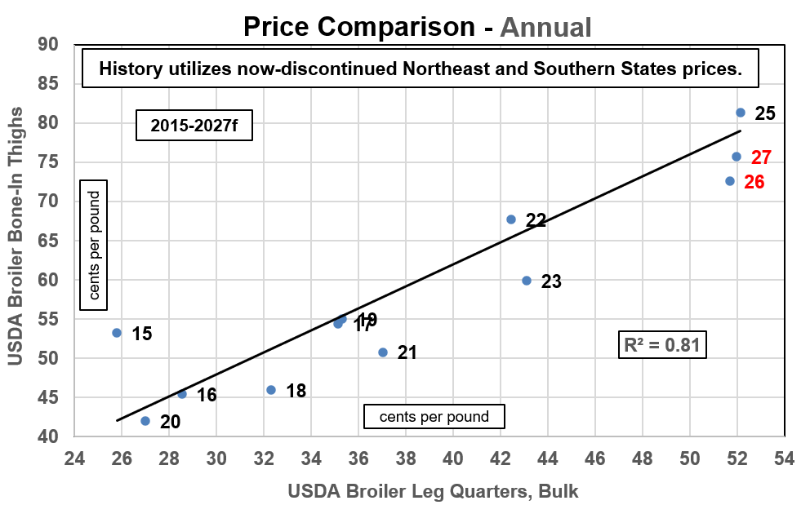
Drumsticks Now Carry Outsized Premiums to Leg Quarters; Bone-In Thighs “Undervalued”
While the drumstick market is strong on a relative basis overall, jumbo/bulk drumstick prices remain in an attractive position.
Sources: USDA-AMS, LEAP Market Analytics
Sources: USDA-AMS, LEAP Market Analytics

Slide 33
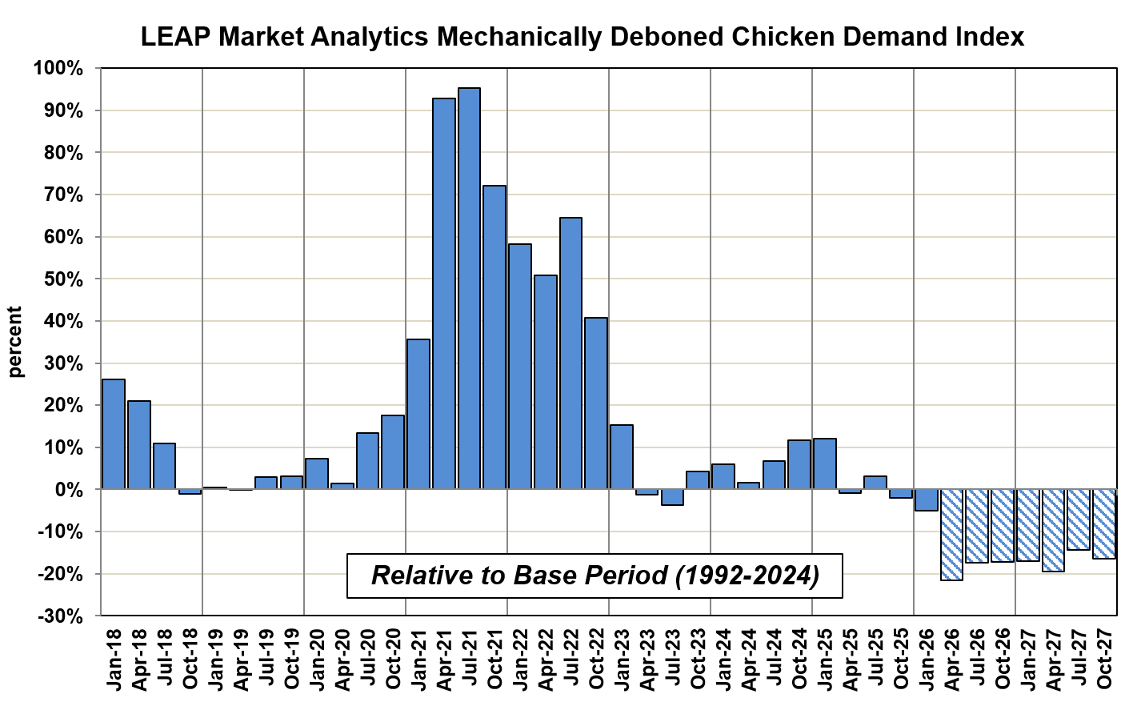
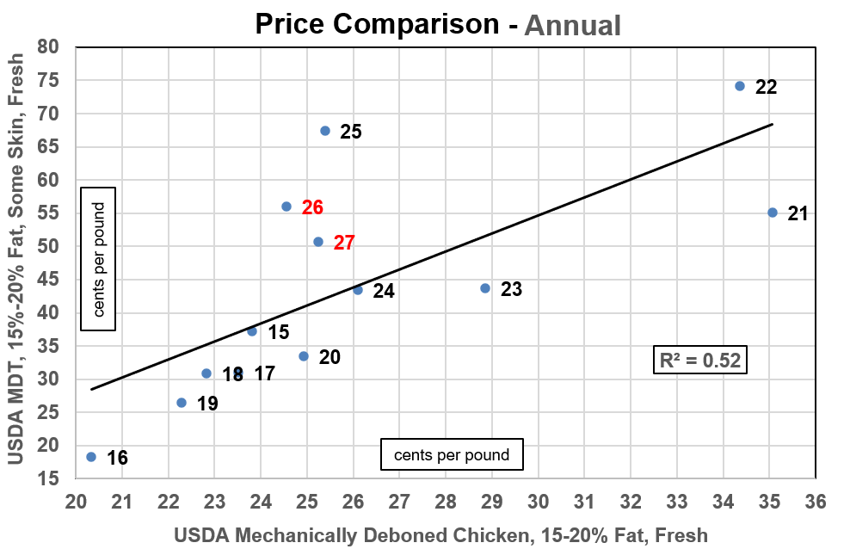
Domestic Demand for Mechanically Deboned Chicken (MDC) Continues to Soften
Not only is MDC “undervalued” on a relative basis to MDT, it’s also cheap compared to fat pork trim (42% lean) and 50% lean beef trimmings.
Source: LEAP Market Analytics
Sources: USDA-AMS, LEAP Market Analytics

Slide 34
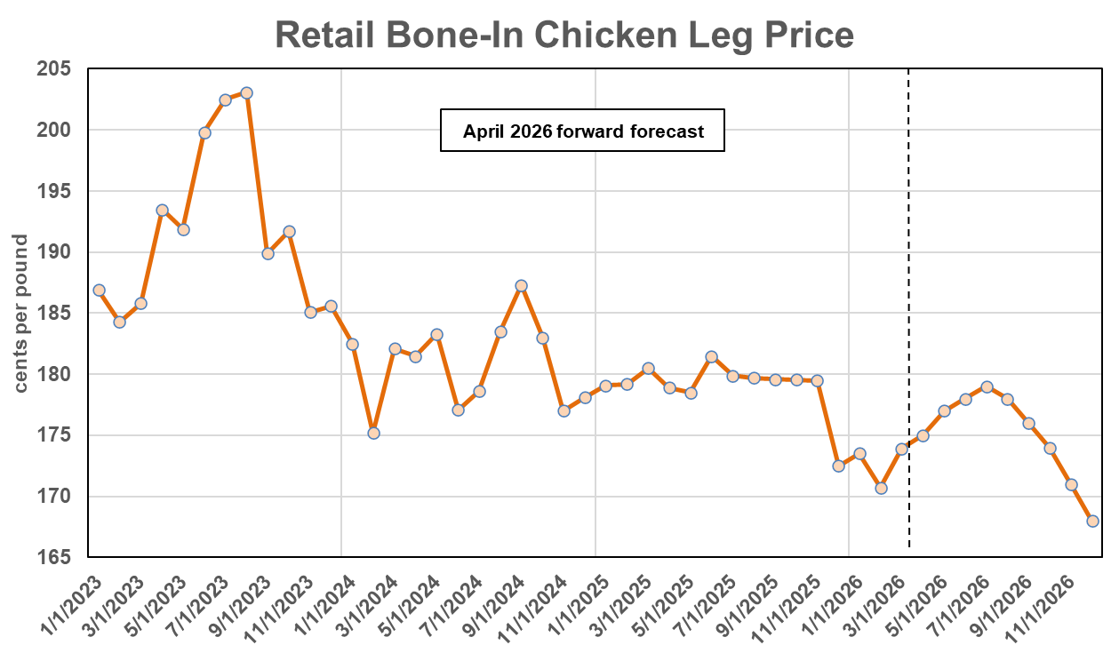
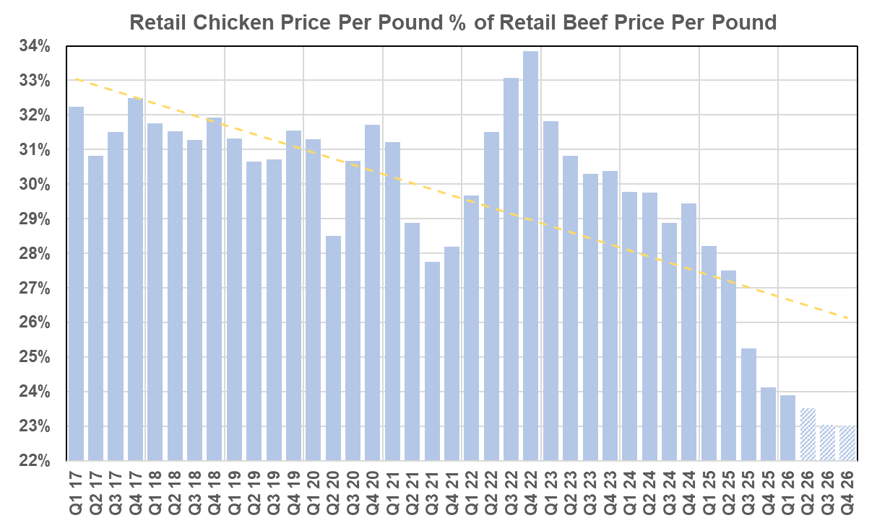
Retail Dark Meat Prices Ease Lower Even as Wholesale Markets Remain Firm
Composite chicken prices have never been this cheap on a relative basis to beef from a consumer-facing standpoint in the U.S.
Sources: BLS, LEAP Market Analytics
Sources: BLS, LEAP Market Analytics

Slide 35
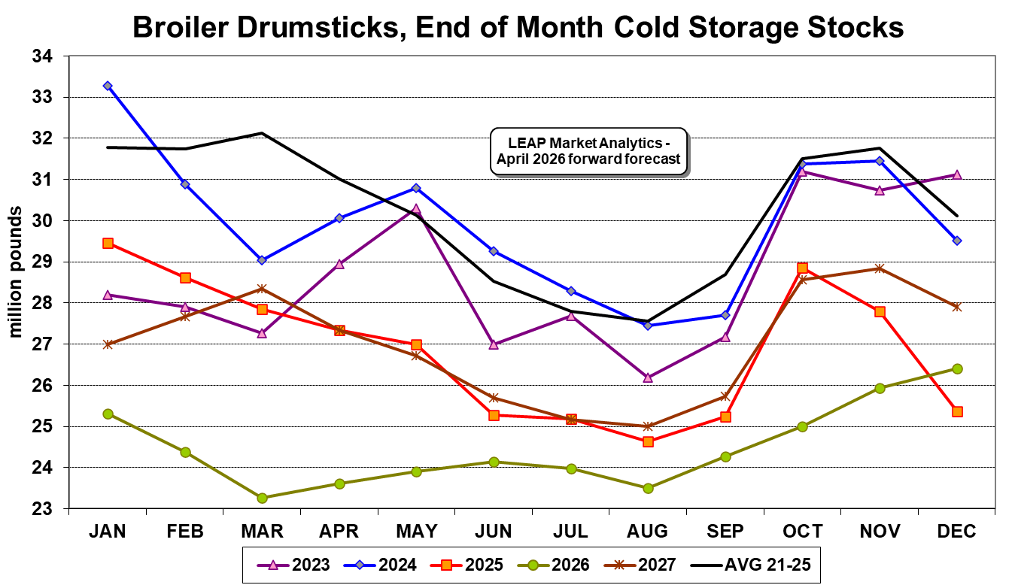
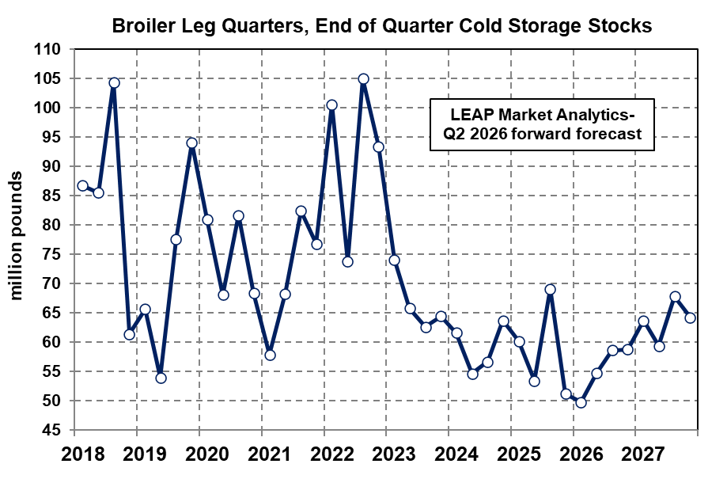
End-of-March Frozen Drum Stocks Were Down 28% from the 5-Year Average
Frozen leg quarter stocks are also running well below prior-year levels and the most recent 5-year (21-25) average.
Sources: USDA, LEAP Market Analytics
Sources: USDA, LEAP Market Analytics

Slide 36
Chicken Production, Trade, and Supply Trends in Latin America
Geopolitical events and questionable foreign policy from the U.S. have created a challenging trade environment over the past year.
Chicken production and consumption trends across Latin America continue to look promising.
Cuba is one of the very few exceptions to this with its recent political and economic turmoil.
Brazil remains formidable as a rival exporter.
HPAI has been less of a stumbling block recently.

Slide 37
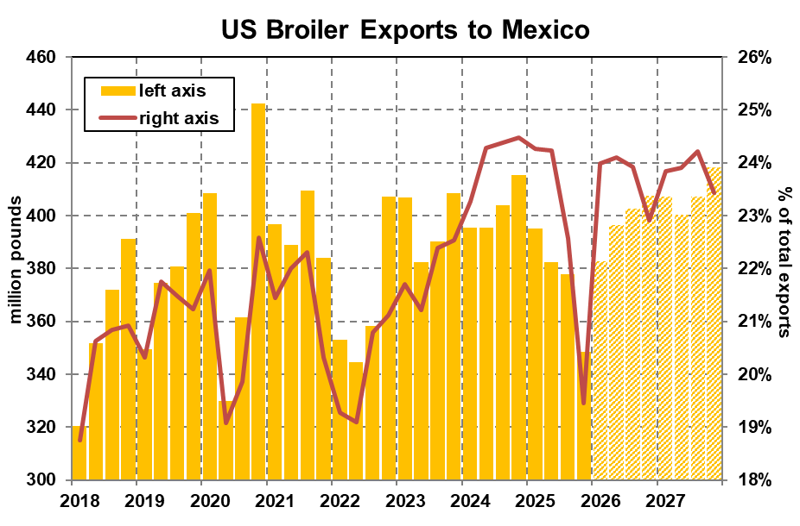
Mexico Imported 6.6% Less Chicken from the U.S. Last Year Compared to 2024
Mexico accounted for 22.5% of total U.S. chicken exports last year. The export pace was sluggish overall last year but particularly weak during the fourth quarter (Oct-Dec), which featured the weakest shipments since the second quarter (Apr-Ju) of 2022.
Taking a step back, export volumes to Mexico have been relatively flat since before the pandemic.
Sources: USDA-ERS, LEAP Market Analytics

Slide 38
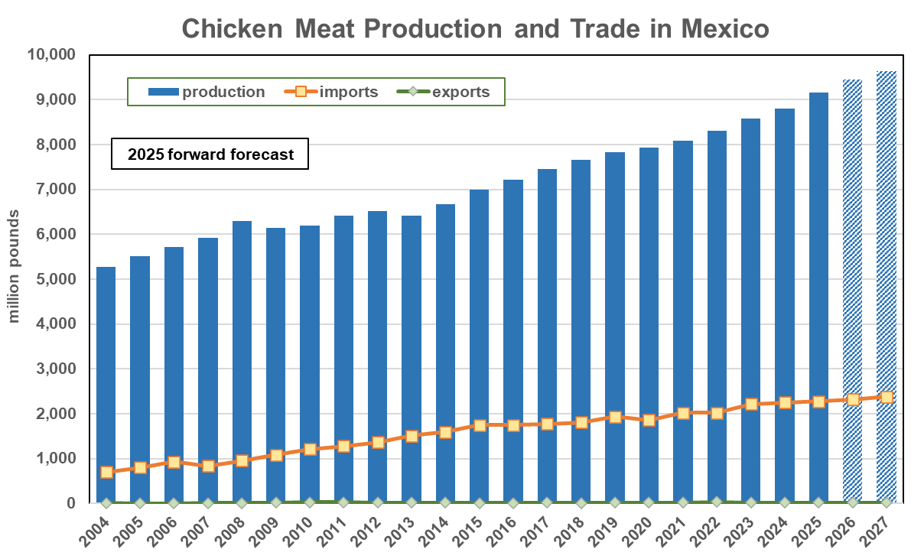
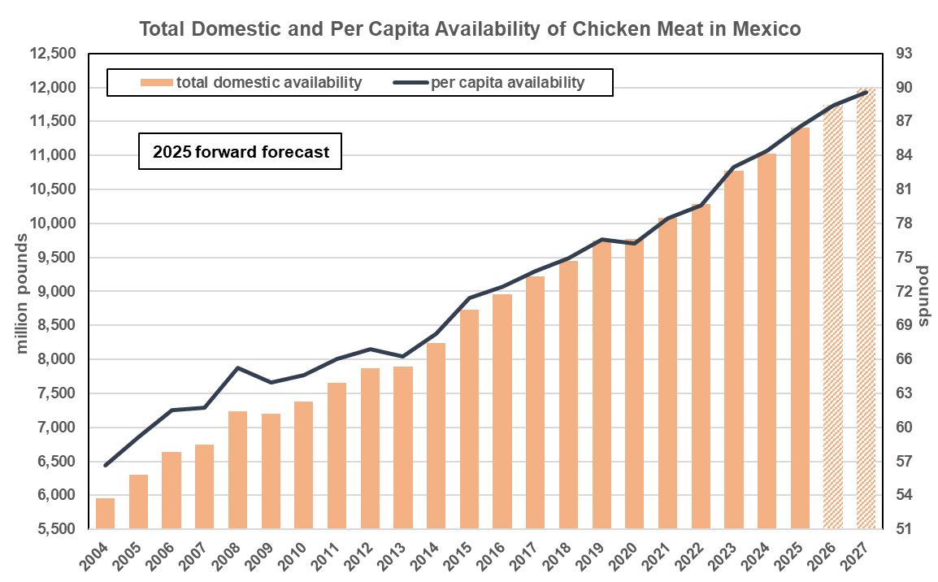
Per Capita Consumption of Chicken in Mexico Is Record Large And Growing
Per capita consumption of chicken in Mexico totaled a record 86.6 pounds (RTC weight) in 2025, an increase of 21% from 10 years prior (2015).
Sources: USDA-FAS, LEAP Market Analytics
Sources: USDA-FAS, LEAP Market Analytics

Slide 39
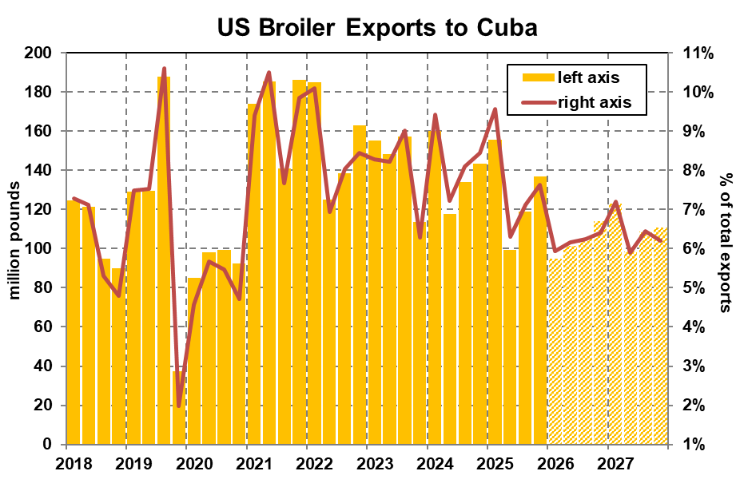
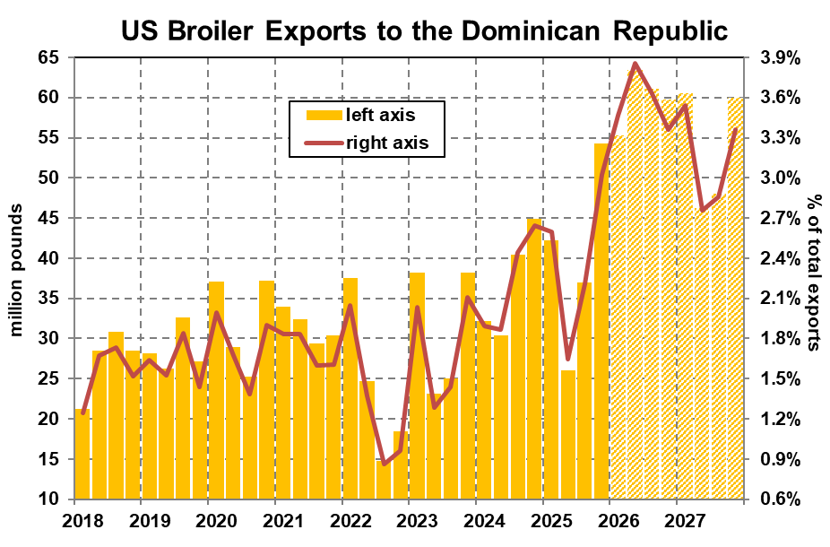
U.S. Chicken Exports to Cuba Slide but Surge to the Dominican Republic
U.S. chicken exports to the Dominican Republic increased 7.9% overall last year and were up 23% from a year earlier during the first two months of 2026.
Sources: USDA-ERS, LEAP Market Analytics
Sources: USDA-ERS, LEAP Market Analytics

Slide 40

Dominican Republic and Haiti Balance Trade Losses with Cuba
Cuba, the Dominican Republic, and Haiti combined accounted for 12.5% of total US chicken exports in 2025. That was second only to a combined 13.7% share in 2021.
Sources: USDA-ERS, LEAP Market Analytics

Slide 41


Production Increases in the Caribbean Slowing Again After Years of Strong Growth
Per capita consumption of chicken in the Dominican Republic increased 37% from 2015 through 2025, representing an average annual increase of 3.2%.
Sources: USDA-FAS, LEAP Market Analytics
Sources: USDA-FAS, LEAP Market Analytics

Slide 42


Guatemala Leads Central American Partners in Importing Chicken from the U.S.
U.S. chicken exports to Guatemala have eased lower ever-so-slightly over the past two years following a burst into record territory in 2023, but the trend is turning positive again.
Sources: USDA-ERS, LEAP Market Analytics
Sources: USDA-ERS, LEAP Market Analytics

Slide 43

The U.S. Exported 450 Million Pounds of Chicken to Central American Nations in 2025
Adjusted for population, Central America’s impact on U.S. chicken trade is comparable to Mexico’s.
Sources: USDA-ERS, LEAP Market Analytics

Slide 44


Chicken Production in Central America Has More Than Doubled Since 2014
Following a massive surge in 2015 and rapid growth through the early 2020s, per capita consumption of chicken in Central America has increased at a more modest pace in recent years.
Sources: USDA-FAS, LEAP Market Analytics
Sources: USDA-FAS, LEAP Market Analytics

Slide 45

U.S. Chicken Exports to Key South American Partners Stabilize Following Years of Decline
After bottoming out in late 2023, in large part because of Colombia restricting imports of U.S. chicken in response to concerns related to HPAI, exports to this group of South American trade partners has gradually, albeit unevenly, recovered.
That said, this bloc of countries accounts for less than 5.0% of the overall export total, firmly below levels from the past.
Sources: USDA-ERS, LEAP Market Analytics

Slide 46

Explosion in U.S. Chicken Exports to South America Circa 2015-19 Proves Unsustainable
Despite the slide from 2020 through 2023, the more recent trend aligns well with the pre-2015 trajectory.
There is more risk to the outlook with this group of countries than with most other countries or regions.
Sources: USDA-ERS, LEAP Market Analytics

Slide 47


Chilean Chicken Production Leveling Off After Surging 8.5% in 2025
Chile has been active in both importing and export chicken over the past several years.
With robust imports complementing domestic production, per capita consumption of chicken is record large and climbing.
Sources: USDA-FAS, LEAP Market Analytics
Sources: USDA-FAS, LEAP Market Analytics

Slide 48


Colombian Chicken Production Has Increased by an Average of 3.4% Per Year Since 2015
Per capita consumption of chicken in Colombia has more than doubled since 2006.
It is fast approaching 100 pounds (RTC weight) per person per year, among the highest in the world.
Sources: USDA-FAS, LEAP Market Analytics
Sources: USDA-FAS, LEAP Market Analytics

Slide 49


Following Setback in 2022-23, Chicken Production in Peru Is Increasing Again
Data revisions reveal incredible, and likely unsustainable, surge in chicken production and availability in 2021-22.
Despite being the highest in the world, per capita chicken consumption in Peru is still climbing.
Sources: USDA-FAS, LEAP Market Analytics
Sources: USDA-FAS, LEAP Market Analytics

Slide 50

U.S. Chicken Exports to Latin America Surging Again Following Setback Last Spring/Summer
After peaking at an all-time high of nearly 26% during the first quarter (Jan-Mar) of last year, Latin America’s (excluding Mexico) share of total U.S. chicken exports pulled back sharply into the 21%-22% area during the second (Apr-Jun) and third (Jul-Sep) quarters but was resurgent by late 2025. Overall, despite an erratic pattern, the prevailing trend over the past 5-6 years is mostly sideways.
Sources: USDA-ERS, LEAP Market Analytics

Slide 51


Chicken Production in South America Is Accelerating, Increasing 3.6% in 2025
Chicken production in South America may be increasing at a pace beyond what export channels can absorb.
Per capita consumption in South America is trending higher again as a result.
Sources: USDA-FAS, LEAP Market Analytics
Sources: USDA-FAS, LEAP Market Analytics

Slide 52
Turkey Market Situation
The competitive landscape of the U.S. turkey industry has a much different look and feel to it following big changes over the past year.
This is due to the emergence of new or perhaps “unfamiliar” companies in this space, including Diestel Family Ranch, Pitman Family Farms (acquiring assets from Cargill), Whitewater Processing (greenfield project in Indiana), and Life Science Innovations/Legacy Turkey.
Expansion in the turkey space is accelerating.
High beef prices are still providing “crossover support.”
Turkey dark meat prices remain very strong.

Slide 53

Very Gradually, HPAI Is Becoming Less of a Problem for the U.S. Turkey Industry
Since March 2025, the average number of commercial meat-type turkeys depopulated because of HPAI exposure per month is below 250 thousand.
Source: USDA-APHIS

Slide 54


This Is Likely to be Only the Second Year Since 2018 Where U.S. Turkey Production Increases
Head counts are increasing but at a relatively modest pace; however, finishing weights are surging fast enough to potentially support a 5%-6% increase in output, at least, in 2026.
Sources: USDA-NASS, LEAP Market Analytics
Sources: USDA-NASS, LEAP Market Analytics

Slide 55


U.S. Turkey Exports Are Running 19% Ahead of The Prior-Year Pace so far in 2026
Mexico now accounts for almost 85% of total U.S. turkey exports on a volume basis.
Canada (2.1%), Guatemala (1.7%), and Costa Rica (1.5%) represent the #2, #3, and #4 destinations, respectively.
Sources: USDA-ERS, LEAP Market Analytics
Sources: USDA-ERS, LEAP Market Analytics

Slide 56


Super-Charged Domestic Demand Continues to Support Sky-High Turkey Thigh Meat Prices
Wholesale spot prices for boneless skinless turkey thigh meat have only recently backed down after spending several months trading around $2.90 per pound or slightly higher.
Source: LEAP Market Analytics
Sources: USDA-AMS, LEAP Market Analytics

Slide 57


Lean Beef Trimmings (90s) Market Provides Ample Spillover Support for Turkey Dark Meat
Both turkey thigh meat and drumstick prices are expected to gradually work lower heading into 2027 with supplies expanding and demand easing, but these markets should remain strong by historical standards.
Sources: USDA-AMS, LEAP Market Analytics
Sources: USDA-AMS, LEAP Market Analytics

Slide 58
Other Proteins
U.S. pork production is increasing but at a very slow pace, with annual growth falling short of 1.0%.
Export development has stalled in recent years outside of Mexico, where hams remain popular.
Domestic loin demand is very soft, generating price points that some importers could find attractive.
U.S. egg supplies are suddenly “overflowing.”
Egg prices should be very attractive to importers.

Slide 59


U.S. Pork Production Is Increasing at a Very Modest Pace
The U.S. hog and pork sector remains more reliant on exports than the cattle/beef, chicken, or turkey sectors, with 25%-26% of all domestic production sent to foreign markets.
Sources: USDA-NASS, LEAP Market Analytics
Sources: USDA-ERS, LEAP Market Analytics

Slide 60


Domestic Ham Demand Has Eased Since the Pandemic and Is Increasingly Mediocre
It’s difficult to understate just how weak pork loin demand in the U.S. is right now, and hog/pork industry stakeholders should be eager to entertain export opportunities, wherever available.
Source: LEAP Market Analytics
Source: LEAP Market Analytics

Slide 61


Wholesale Pork Prices Increased Nearly 8% in 2025 Despite Loin Prices Easing Slightly Lower
Pork loins are still “undervalued” relative to the rest of the cutout but not quite to the degree they were last year. This market has been the biggest drag on the cutout over the past couple of years.
Sources: USDA-AMS, LEAP Market Analytics
Sources: USDA-AMS, LEAP Market Analytics

Slide 62


Domestic Per Capita Availability of Processed Eggs Advances Toward Record Territory
There is evidence suggesting that graded shell egg supplies are larger than the official data indicates.
The export share of domestic egg production is hovering near modern lows.
Sources: USDA, LEAP Market Analytics
Sources: USDA-ERS, LEAP Market Analytics

Slide 63


Tanking U.S. Demand for Shell Eggs Creates Price Opportunities for Importers
Processed egg prices are discounted more than we might expect based on where graded shell egg markets are trading because of how “full” the supply chain is in that space.
Source: LEAP Market Analytics
Sources: USDA-AMS, LEAP Market Analytics

Slide 64


Slide 65
Poultry and Other Protein Market Trends in the United States and Latin America
Mark Jordan
Executive Director
LEAP Market Analytics
mark.jordan@leapmarkets.com

